Slide 1

Presented By :
Gunjan Gupta (B150234265)
Ranjit More (B150234317)
Shantanu Takalgavankar (B150234396)
Sayali Tembe (B150234371)

Slide 2
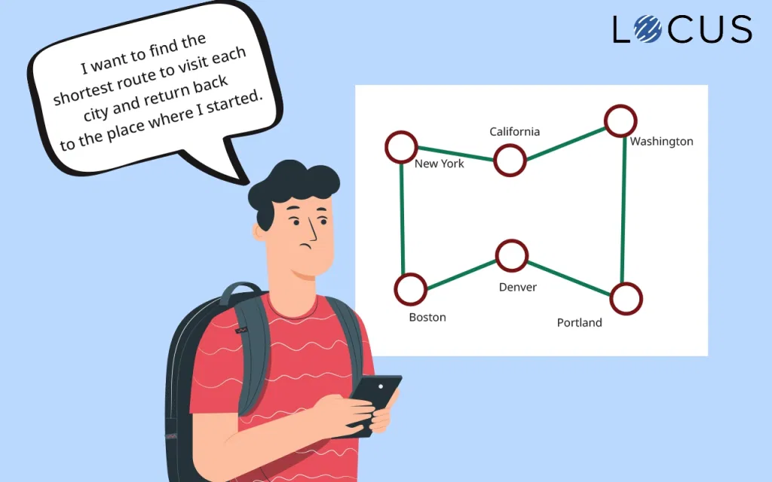
Travelling Salesman Problem (TSP):
TSP is a famous problem where - there is a salesman and he
wants to sell his goods in different cities.
Therefore, the salesman leaves a city, visits each of the
cities exactly once and returns back to the starting point.

Slide 3
Characteristics of TSP -
The journey begins and ends from and to the initial city.
There are several cities, all of which must be visited exactly once.
Travel must not return to the initial city before all the destination cities visited.
The purpose of this problem is to reduce the distance visited by salesperson by arranging the order of cities to be visited.

Slide 4
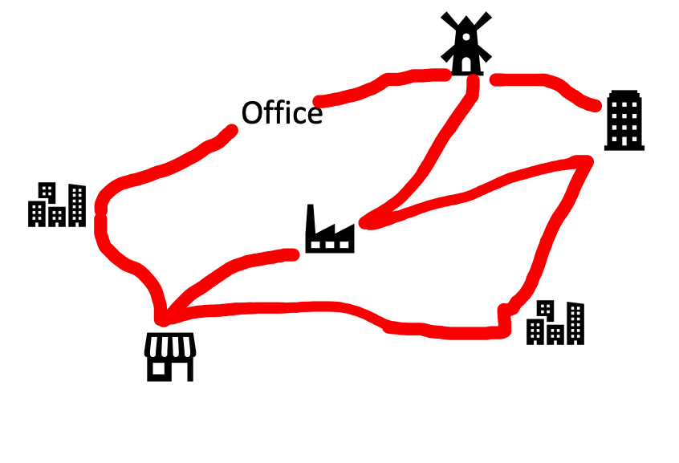
Applications of TSP:
The TSP is represented in numerous transportation and logistics applications such as -
Arranging routes for school buses to pick up children in a school district.
Delivering meals to home-bound people.
Scheduling stacker cranes in a warehouse.
Planning truck routes to pick up parcel posts.

Slide 5
Genetic Algorithm(GA):
Optimization is the process of finding a better solution to a problem.
Genetic algorithm generates a population of solutions and then allows them to evolve through the process of natural selection – poor solutions tend to die out, while better solutions survive and reproduce(survival of fittest).
By repeating this process over and over again, the genetic algorithm breeds an optimal solution.

Slide 6
How does GA optimize TSP?
First, we need to decide how to represent a route of the salesman. The most natural way of representing a route is the path representation. Each city is given an alphabetic or numerical name, the route through the cities is represented as a chromosome, and appropriate genetic operators are used to create new routes.
Suppose we have nine cities named from 1 to 9. In a chromosome, the order of the integers represents the order in which the cities will be visited by the salesman.

Slide 7
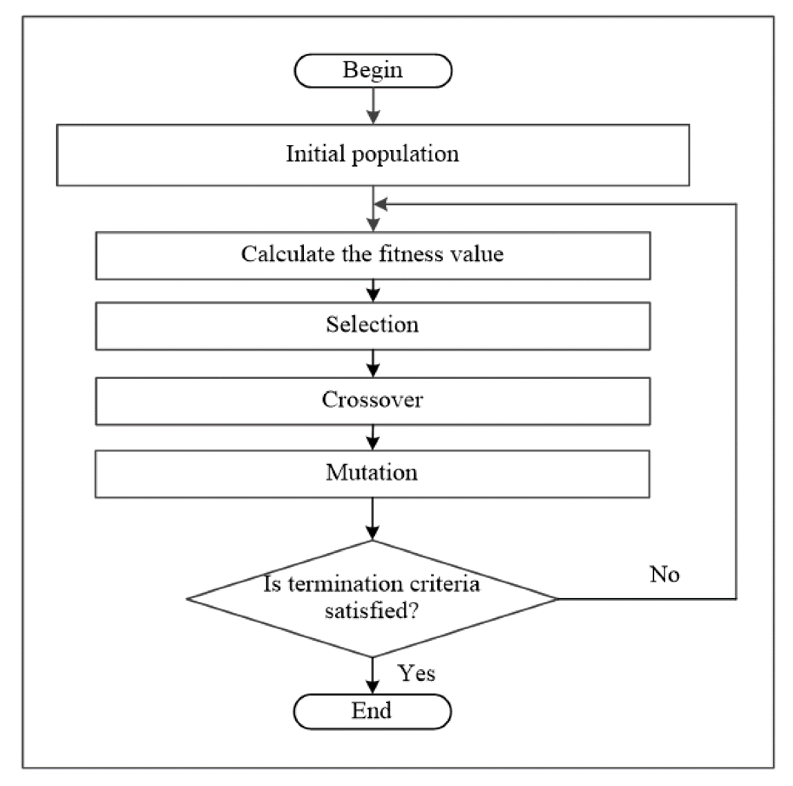
5 Phases of GA:
Initial population
Fitness function
Selection
Crossover
Mutation

Slide 8
Initial Population:
The process begins with a set of solutions which is called a Population
An solution is characterized by a set of parameters (variables) known as Genes. Genes are joined into a string to form a Chromosome (solution).

Slide 9
Fitness Function:
The fitness of each individual chromosome (solution) is determined as the reciprocal of the route length.
In other words, the shorter the route, the fitter the chromosome i.e. better the solution.
The probability that an individual will be selected for reproduction is based on its fitness score.

Slide 10
Selection:
The idea of selection phase is to select the fittest individuals and let them pass their genes to the next generation.
Two pairs of individuals (parents) are selected based on their fitness scores. Individuals with high fitness have more chance to be selected for reproduction.

Slide 11
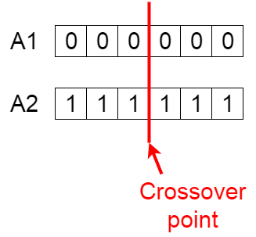
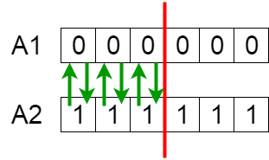
Crossover:
Crossover is the most significant phase in a genetic algorithm. For each pair of parents to be mated, a crossover point is chosen at random from within the genes.
Offspring are created by exchanging the genes of parents among themselves until the crossover point is reached.

Slide 12
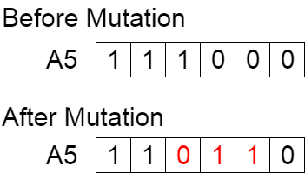
Mutation:
In certain new offspring formed, some of their genes can be subjected to a mutation with a low random probability. This implies that some of the bits in the bit string can be flipped.
Mutation occurs to maintain diversity within the population and prevent premature convergence.

Slide 13
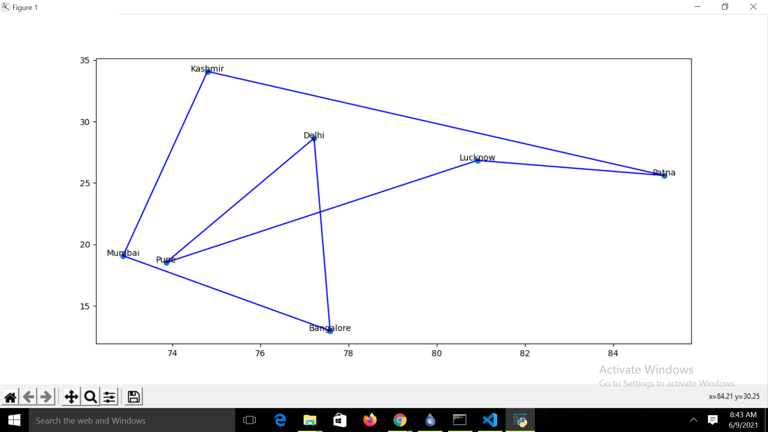
TSP Before GA

Slide 14
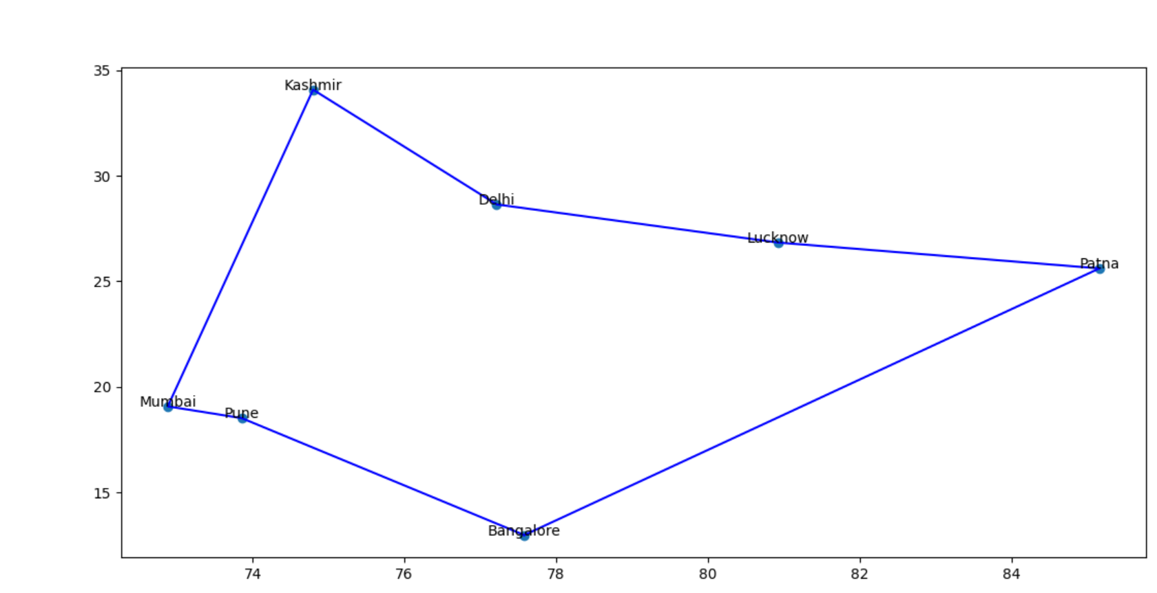
After GA:

Slide 15
Conclusion:
In our project, we have successfully optimized the solution of our Travelling Salesman Problem.

Slide 16


